Slide 1
Unit 8

Slide 2
Grammar: Present simple, present continuous, present perfect Review Mid-term test
TABLE OF CONTENT

Slide 3
GRAMMAR

Slide 4
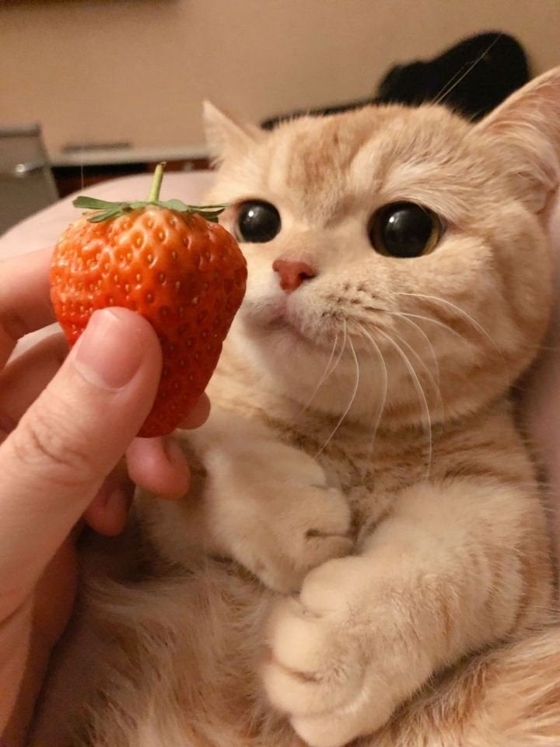
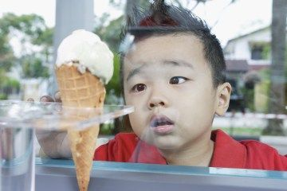
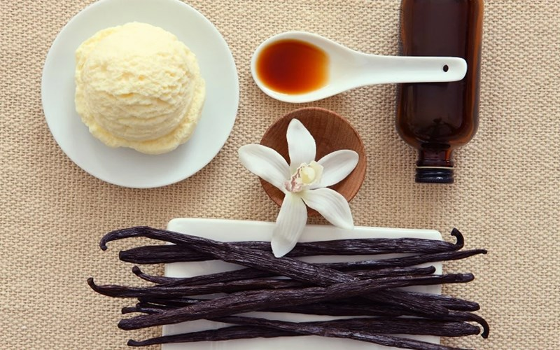
1. Present Simple Tense
a. How to form Present Simple Tense
- In the Simple Present, most regular verbs use the root form.
X except in the third-person singular (which ends in –s).
Example: he wants, she needs, he gives, she thinks
- Negative and question forms use DOES (= the third person of the auxiliary ‘DO’) + the infinitive of the verb
Example:
He wants ice-cream.
Does he want strawberry?
He does not want vanilla.

Slide 5
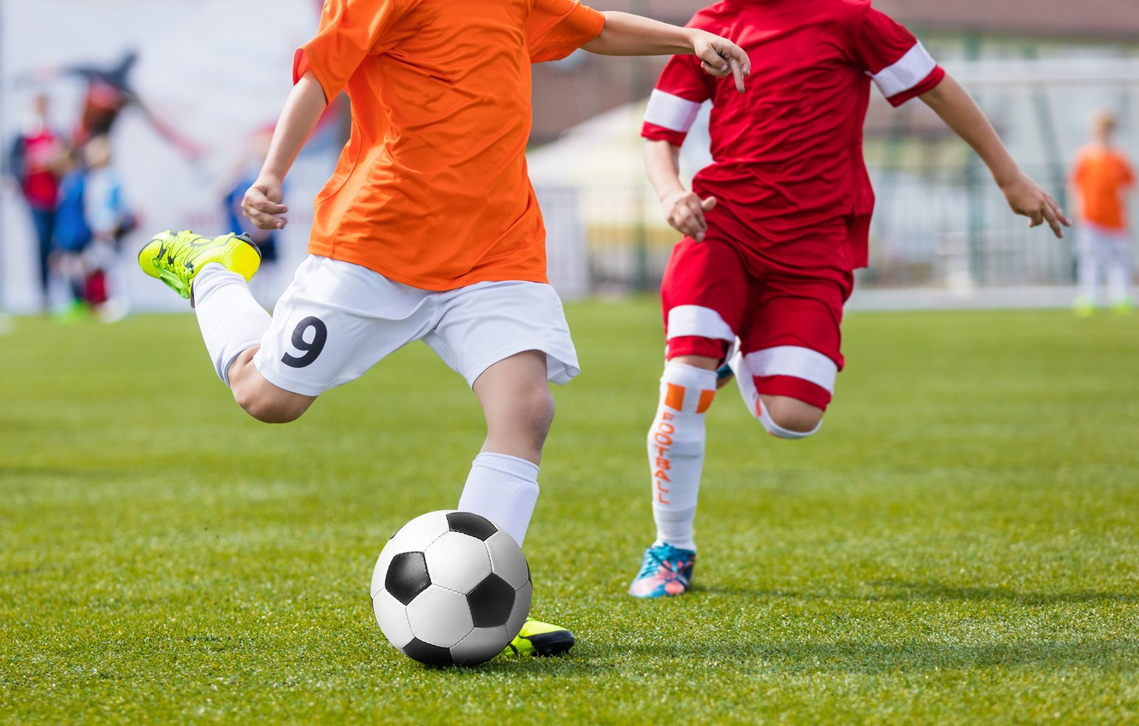

1. Present Simple Tense
a. How to form Present Simple Tense
- Verbs ending in –y: the third person changes the –y to –ies:
Example: fly --> flies; cry --> cries…
Exception: if there is a vowel before the –y:
Example: play --> plays; pray --> prays…
- Add –es to verbs ending in: -ss; -x; -sh; -ch, o,
Example: he passes; she catches; he fixes; it pushes…
b. The Present Simple Tense is used
- To express sth that happens regularly, repeated actions in the present:
Example: I play football every weekend.
- We often use adverbs of frequency like sometimes, always and never:
Example: I sometimes go to the cinema.

Slide 6
1. Present Simple Tense
b. The Present Simple Tense is used
- To express general truths, or unchanging situations, emotions and wishes:
Example: London is a large city. (general truth)
I work in London. (unchanging situation)
- To express future time, after some conjunctions: after, when, before, as soon as, until:
Example: He will give it to you when you come next Saturday.
Use the Simple Present for future events that are certain to take place:
He comes back tomorrow.
When does the train leave?
c. Signal words
- Adverbs of frequency: always > usually > often = sometimes > hardly = barely = scarcely=rarely > never
- Everyday/ week/ month…
- Once a day/week/month; twice a day/week/month; three times…

Slide 7
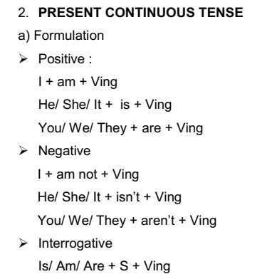

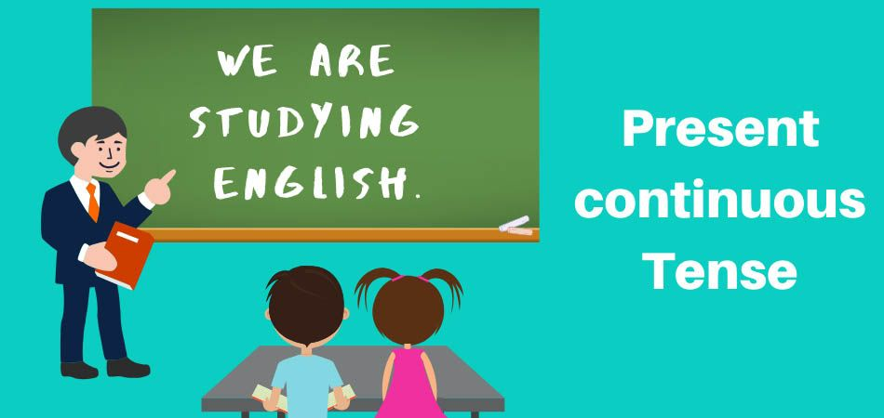



Slide 8
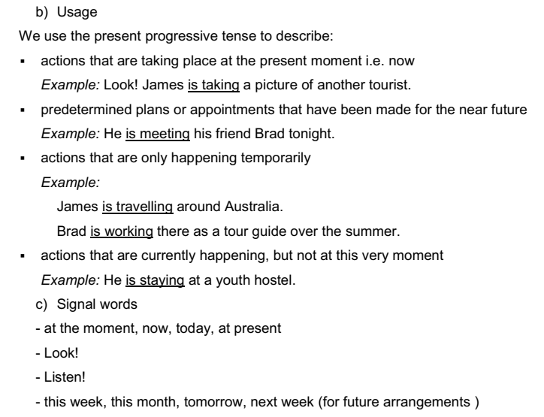
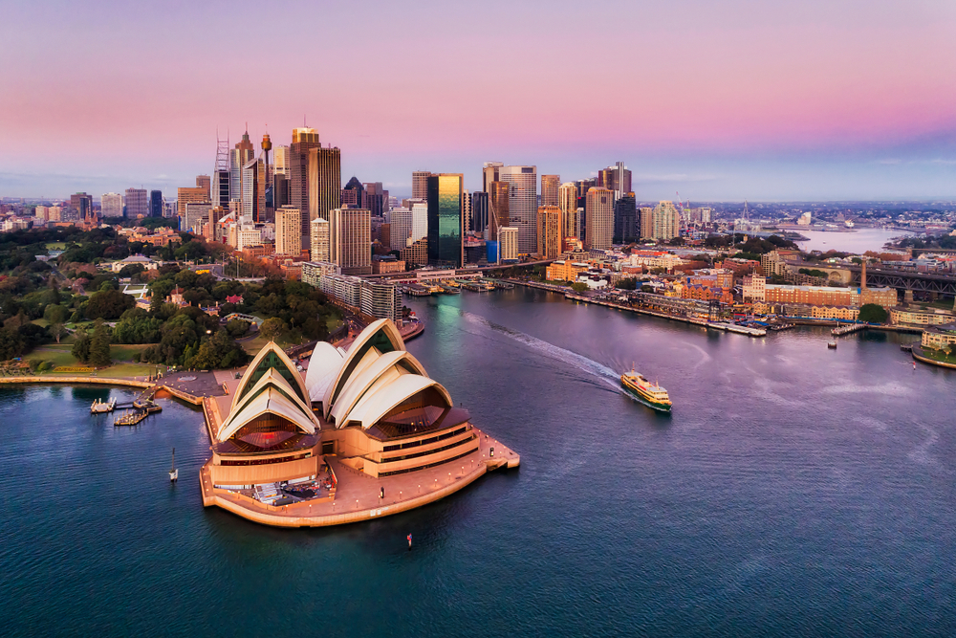

Slide 9
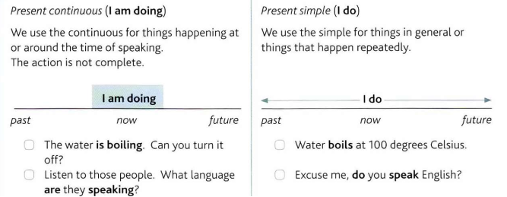
Present Continuous vs. Present Simple

Slide 10
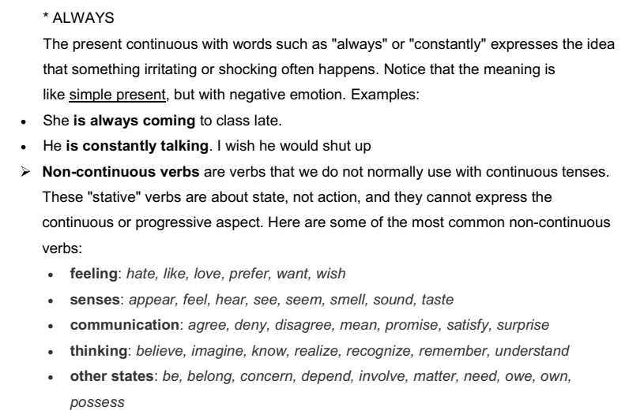

Slide 11
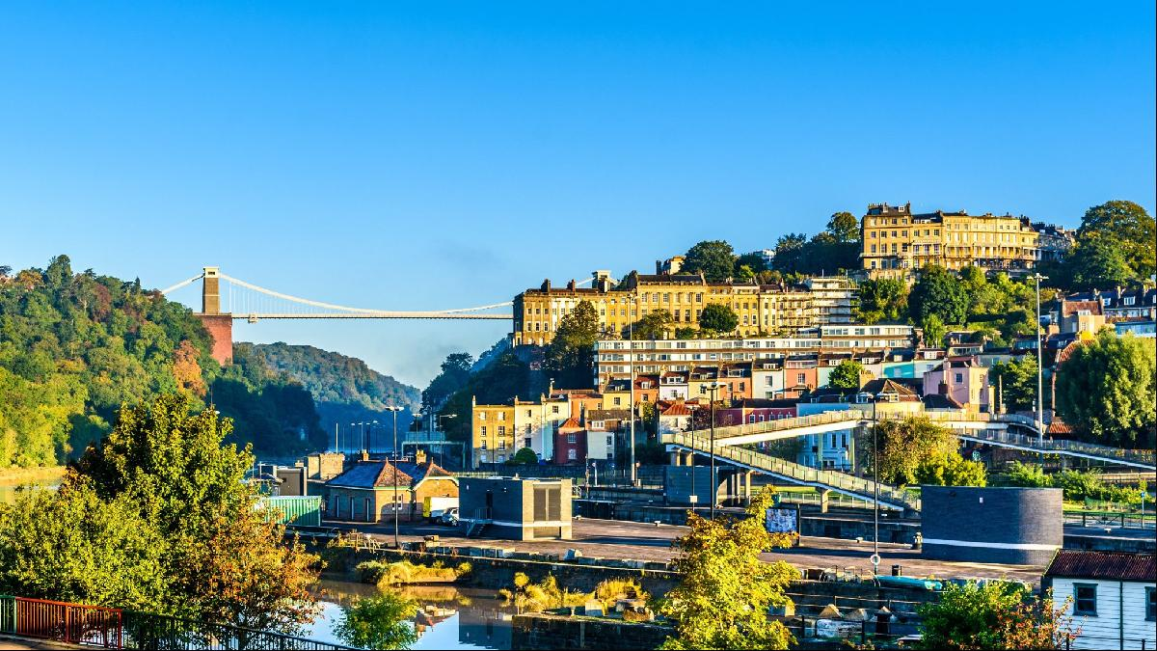
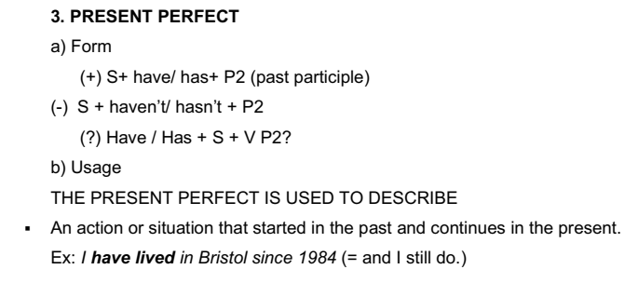

Slide 12
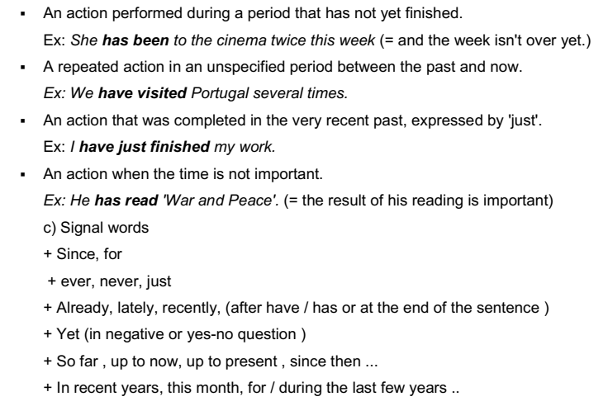

Slide 13
PRACTICE

Slide 14
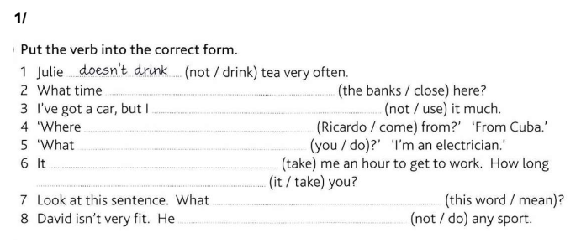
do the banks close
don’t use
does Ricardo come from
do you do
takes
does it take
does this word mean
doesn’t do

Slide 15
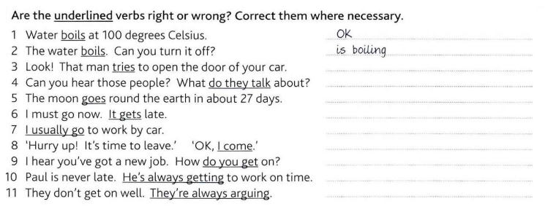
is trying
are they talking
OK
It’s getting / It is getting
OK
I’m coming / I am coming
are you getting
He always gets
OK

Slide 16
3/ FOR or SINCE
1. I haven't phoned home SINCE Christmas.
2. We've been here SINCE nine o'clock.
3. I have worked for International House FOR more than eight years.
4. I haven't visited my home town SINCE I left school.
5. I haven't been to the cinema FOR ages.
6. I have studied non-stop SINCE 9.15.
7. I have had a driving licence SINCE I was eighteen.
8. She hasn't had a day off SINCE 1999.
9. Johan has been in England FOR more than two weeks now.
10. Peter has been my best friend SINCE we were nine.
………
………
………
………
………
………
………
………
………
………

Slide 17
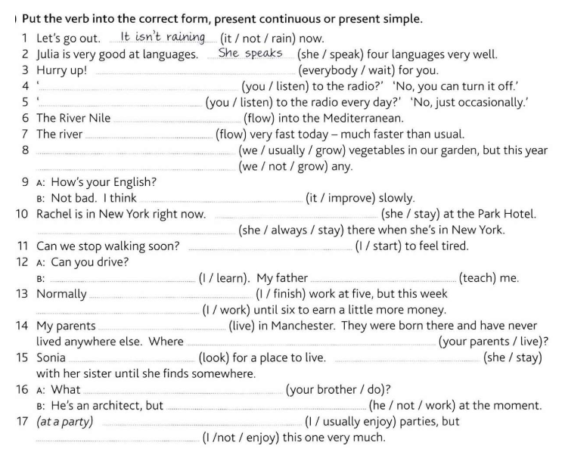
Everybody is waiting
Are you listening
Do you listen
flows
is flowing
We usually grow
we aren’t growing
it is improving
She is staying
She always stays
I am starting
I am learning
is teaching
I finish
I am working
live
do your parents live
is looking
is staying
does your brother do
he isn’t working
I usually enjoy
I am not enjoying

Slide 18
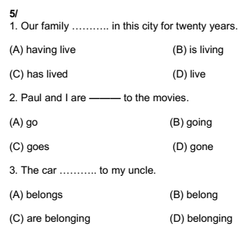
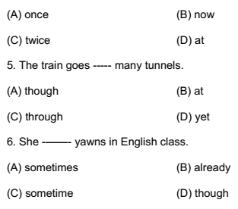

Slide 19
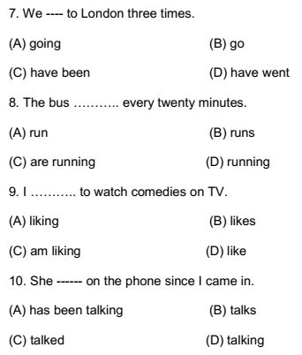
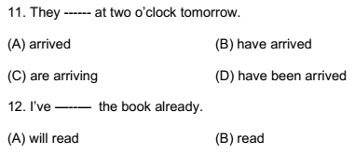
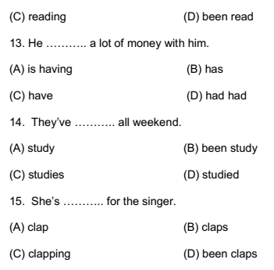
ing

Slide 20
THANKS!

Slide 21
HOMEWORK

Slide 22
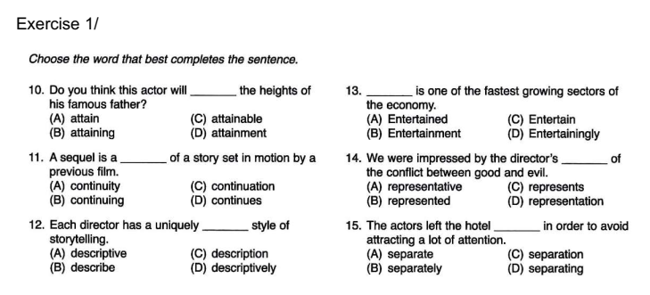

Slide 23
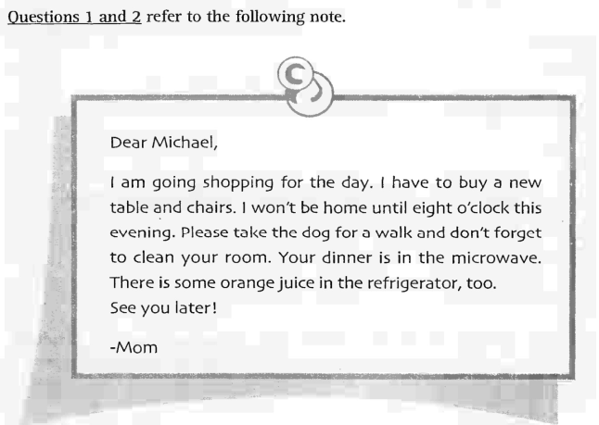
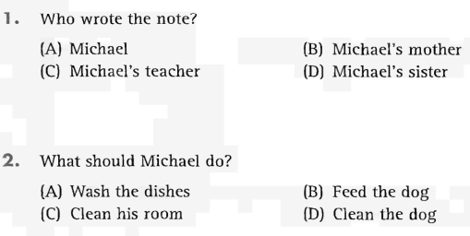

Slide 24
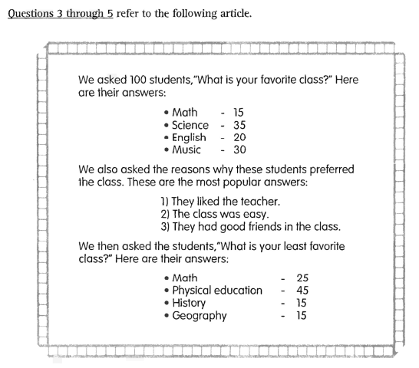
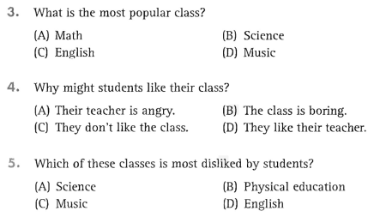

Slide 25
